Slide 1
MONTEZUMA Volunteer firefighter program

Slide 2
Resident Volunteer Firefighter
No changes to the volunteer program
Training: Must meet 60 % of all training for the year
Calls: Must meet 25 % of all calls for the year
May sign up for 12-hour shifts – Still reimbursed Per-Call

Slide 3
Reserve volunteer firefighter
Shift participation: Minimum 3 shifts a month* in leu of a call percentage
Training: On shift in lieu of Tuesday night training
* Would like to change to 1 day per week (minimum)

Slide 4
Student fire explorer
Non-life safety position
Age range 14 years old to 18 years old
Limited to non active incidents (mop up only)
No structure fire (clean up only)

Slide 5
Support volunteer
Non-life safety position
Logistical
Food, water, support functions
Assist with explorer program

Slide 6
Summer staffing
7/1/2023 thru 11/10/23 (3 months)
3 personnel per day 8 am to 5 pm $26,924.33
$35 per day total $6,300 (3 months)
$50 per day total $9,000 (3 months)
7/1/2022 thru 6/30/2023 (1 Fiscal Year)
3 personnel per day 8 am to 5 pm $57,084.23
$35 per day total $27,300 (1 Fiscal Year)
$50 per day total $39,000 (1 Fiscal Year)

Slide 7
MONTEZUMA Reserve Volunteer firefighter program
$35 per day per person 5 days a week | $50 per day per person 5 days a week
$9,100 – 1 person per day for 1 year | $13,000 – 1 person per day for 1 year
$18,200 – 2 personnel per day for 1 year | $26,000 – 2 personnel per day for 1 year
$27,300 – 3 personnel per day for 1 year | $39,000 – 3 personnel per day for 1 year
$36,400 – 4 personnel per day for 1 year | $52,000 – 4 personnel per day for 1 year

Slide 8
PRO’S / Conn's
Pro’s | Conn’s
Coverage 5 days a week 52 weeks a year | Possible loss of volunteers
Coverage 12 hours a day (7 am to 7 pm) | Split paid staff
More cost effective | Turn over rate
Maintain high training levels | Onboarding cost
Possible strike team staffing
Larger recruitment area

Slide 9
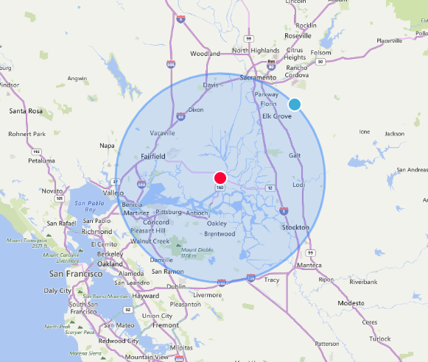
This program allows us to recruit up to 30 air miles
With in this area, we can recruit from Solano college, Loss Medanos, San Joaquin Delta College

Slide 10
Questions?

